Slide 1

Final Year Project Presentation on “Stock Price Prediction
Using Additive Regression Models’’
Group Members: Project Guide:
Ketan Mahandule Prof. Arunadevi Khaple
Niraj Kulkarni
Yash Joshi
Shreyas Natu

Slide 2
Contents
Abstract
Problem Statement
Introduction
Literature Survey
Modules Specification
Methodology
Implementation
Applications
Future Scope
Conclusion
References

Slide 3
Abstract
This project investigates the usage of Python and fbprophet for stock price prediction. It outlines the approach used to create the prediction model after reviewing relevant literature on stock price prediction. The fbprophet model was trained using historical stock prices and technical indicators as inputs, and its accuracy was evaluated using new data. It provides a thorough overview of the numerous machine learning methods, such as additive regression models and time series analysis, that are used to forecast stock prices. The findings reveal that the fbprophet model predicts stock values well, even beating other machine learning models in several circumstances. In addition, utilizing historical stock market data and the fbprophet model, the research provides a methodology for projecting stock market trends based on technical analysis. The results show that the fbprophet model has a high potential for short-term stock market trend prediction, which can assist financial professionals make better judgements about stock purchases and sales.

Slide 4
Problem Statement
Investors face significant challenges in predicting future stock prices due to the inherent unpredictability of the stock market.
However, accurate predictions could lead to substantial profits.
Despite differing opinions on the predictability of the stock market, the ability to accurately forecast stock prices could provide valuable insights and opportunities for investors to maximize their returns.
The problem is how to develop effective methods and technologies to accurately predict future stock prices.

Slide 5
Introduction
Some Interesting Facts:
According to a study by DALBAR Inc., the average retail investor significantly underperforms the stock market, with an average annual return of just 2.6% over the past 20 years, compared to the S&P 500's average annual return of 6.4% over the same period.
Research by Morningstar found that actively managed mutual funds, which rely on human stock-picking expertise, underperformed passively managed funds (such as index funds) in almost every asset class and over every time period studied.
In contrast, a report by PwC found that AI-powered investment management systems could potentially increase the total assets under management (AUM) of the asset management industry by up to $15 trillion by 2025, thanks to their ability to quickly and accurately analyze large volumes of data and identify profitable investment opportunities.
Additionally, a survey by EY found that asset managers who have implemented AI solutions have seen significant improvements in their investment performance, with 64% reporting improved risk management and 61% reporting improved returns.

Slide 6
Introduction
About Our Project:
This project aims to develop a strategy for predicting the real-time prices of US-based companies using a multi-variate, single-step forecasting approach.
To achieve this, the project uses Facebook's Time Series forecasting algorithm, Prophet, which is a high-end additive regression model.
The project involves obtaining and augmenting the necessary dataset, splitting it into training and validation sets, loading and compiling a base model, and evaluating the model using the validation set.
The ultimate goal of the project is to successfully predict the future value of US stocks, potentially providing valuable insights and opportunities for investors to maximize their returns.

Slide 7
Literature Survey
Sr. No. | Name of the Paper | Advantages | Disadvantages
1 | Stock Price Analysis and Prediction using Facebook Prophet Model with Python | Uses the FB Prophet model, which is open source and easy to implement, making it accessible to a wide range of users | Does not compare the effectiveness of the FB Prophet model to other machine learning algorithms
2 | Stock Price Prediction using Machine Learning | Can be used to predict stock prices accurately, reducing the risk of losses for investors | Only focuses on one type of machine learning algorithm, limiting the scope of the study
3 | Stock Price Prediction Using Machine Learning Techniques | Uses multiple machine learning algorithms to predict stock prices, providing a more comprehensive analysis | Does not compare the effectiveness of the different algorithms used
4 | Stock Index Probability Prediction using the FB Prophet Model | Uses the FB Prophet Model, which is specifically designed for time series analysis, making it a strong tool for stock price prediction | Only focuses on one model, limiting the scope of the study
5 | Effective Stock Price Prediction using Time Series Forecasting | Uses a combination of time series forecasting and machine learning algorithms, providing a more accurate prediction | The study only focuses on a specific type of stock, limiting the scope of the study

Slide 8


Module Specification
There are three modules in this system:
Stock Data Import We import data from Yahoo Finance using the yfinance Python Library.
Data Analysis using fbprophet Identify trends and patterns in the data to inform future predictions
Closing Price Prediction Generate a closing price prediction based on the models’ analysis along with its uncertainty

Slide 9
Stock Data Import
Why use yfinance?
yfinance is a Python library that allows developers to easily access and download historical and real-time financial market data from Yahoo Finance.
With yfinance, users can retrieve data on a wide range of financial instruments, including stocks, ETFs, mutual funds, currencies, and cryptocurrencies, among others. The library provides a simple and user-friendly interface for accessing this data, making it a popular tool for financial analysts, traders, and investors.
List of attributes we consider for feature engineering:
start_date
end_date
closing_price
history

Slide 10
Data Analysis using fbprophet
Why use fbprophet?
Fbprophet is an open-source time series forecasting tool developed by Facebook's Core Data Science team. It is built on top of the Python programming language and uses a decomposable additive time series model to make predictions.
One of the main advantages of fbprophet is its ease of use. It requires minimal data preprocessing and tuning of model parameters, making it a great choice for non-experts in time series forecasting.
Another key feature of fbprophet is its ability to handle a variety of time series patterns, such as seasonality, holidays, and trends, without the need for manual intervention. This is achieved through the use of Bayesian inference to estimate model parameters and uncertainties.

Slide 11
fbprophet Algorithm
Steps involved in fbprophet algorithm:
fbprophet is an open-source algorithm for generating time-series models.
It models the overall trend of the data using a growth function, a seasonality function, and a holiday/event function.
The growth function has three main options: linear, logistic, and flat trend.
The seasonality function is a Fourier Series that approximates the cyclical pattern in the data.
Prophet can automatically detect an optimal number of terms in the series or you can choose the Fourier order based on your needs.
The holiday/event function adjusts the forecast when a holiday or major event may change the forecast.
It takes a list of dates and adds or subtracts value from the forecast based on historical data.

Slide 12
Closing Price Prediction
The closing price is an important metric for investors as it represents the final price of a stock at the end of a trading day.
Predicting the closing price can help investors make informed decisions about when to buy or sell a stock.
The accuracy of the predictions is evaluated using various metrics such as Mean Absolute Error (MAE) and Root Mean Squared Error (RMSE).
The results of the model predictions were visualized using charts and graphs to facilitate easy interpretation of the data.

Slide 13
Methodology
Data Preprocessing: Collect historical stock price data from yfinance API. Preprocess the data to clean it, fill missing values, and prepare it for modeling.
Model Selection: Choose the appropriate model for stock price prediction. In this case, we will use the fbprophet algorithm.
Model Training & Testing: Train the selected model on the prepared data to learn patterns and trends in the data. Test the trained model on a portion of the data that was not used for training to evaluate its accuracy.
Model Optimization: Adjust the hyperparameters of the model to improve its performance and accuracy.
Prediction: Use the trained and optimized model to make predictions on future stock prices.
Visualization: Visualize the predicted stock prices and compare them with actual stock prices to evaluate the accuracy of the model.
Evaluation: Evaluate the performance of the model using various metrics such as mean absolute error (MAE), mean squared error (MSE), and root mean squared error (RMSE).
Deployment: Deploy the model to make real-time predictions on new stock price data.

Slide 14
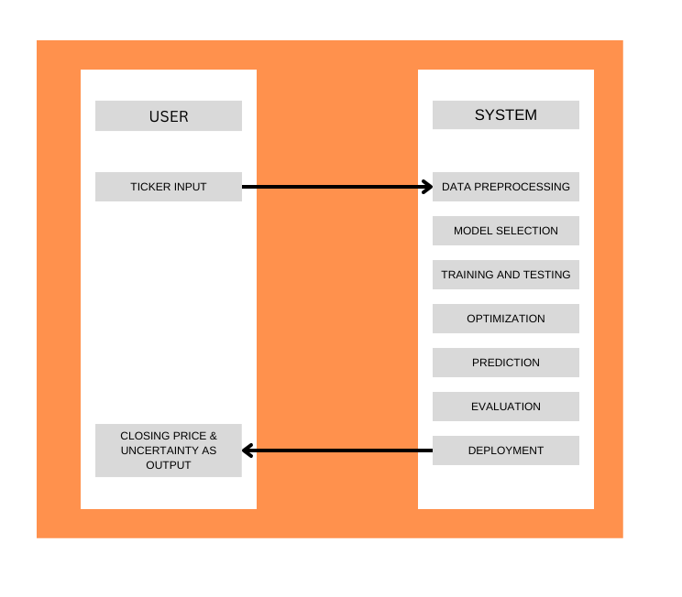
Fig. Block Diagram

Slide 15
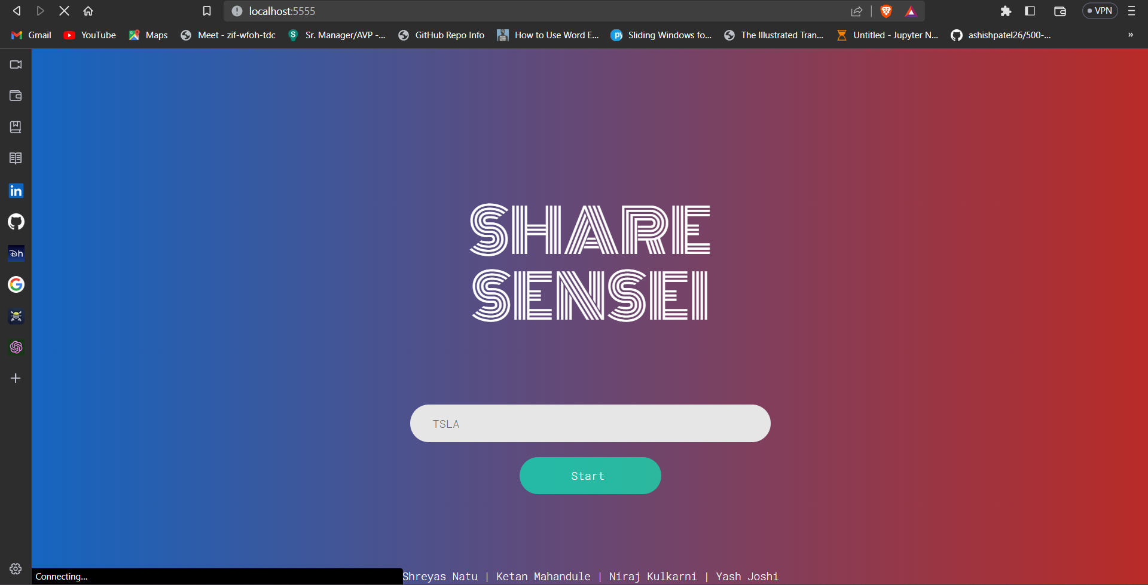
Implementation
Fig. Home Page

Slide 16
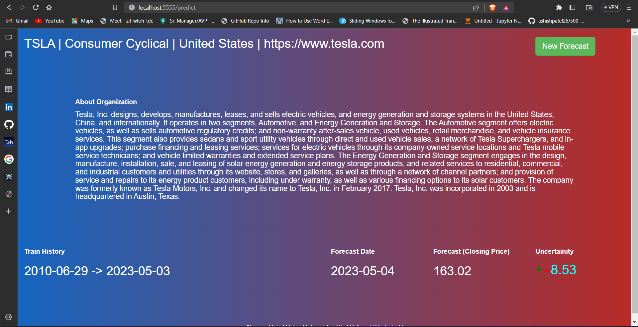
Fig. Predicting the Closing Price of Tesla Stock

Slide 17
Applications
Investment decision making: Investors can use the predictions generated by the model to make informed decisions about when to buy or sell particular stocks.
Risk management: Financial institutions and traders can use the predictions to better manage risks associated with their investments.
Trading strategies: The predictions can be used to develop trading strategies for short-term and long-term investments.
Portfolio optimization: The model can help optimize investment portfolios by predicting which stocks will perform well in the future.
Research: The model can be used to conduct research into financial markets, investor behavior, and other related areas.

Slide 18
Future Scope
Finding a way to incorporate Indian Stock market data(NSE, BSE) in the model to yield profits and help the Indian Economy.
Incorporating more features and data sources such as economic indicators, news sentiment analysis, and market trends could improve the accuracy of the predictions.
Implementing more sophisticated hyperparameter tuning techniques, such as Bayesian optimization or genetic algorithms, may help optimize the model's parameters and improve its performance.
Developing a more robust backtesting framework to evaluate the model's performance on historical data and assess its ability to generate profitable trading strategies.
Deploying the model in a live trading environment and monitoring its performance over time can help identify areas for further improvement and refinement.

Slide 19
Conclusion
The system offers high reliability, accuracy, efficacy, and robustness, with less processing time, smaller error, and lower cost.
The application of Facebook's Time Series forecasting algorithm Prophet in predicting stock market prices of US-based companies in real-time using multivariate, single-step forecasting strategy shows promising results for future optimization and improvements.

Slide 20
References
1. B. N. Varaprasad, C. Kundan Kanth, G. Jeevan and Y. K. Chakravarti, "Stock Price Prediction using Machine Learning," 2022 International Conference on Electronics and Renewable Systems (ICEARS), Tuticorin, India, 2022, pp. 1309-1313, doi: 10.1109/ICEARS53579.2022.9752248. 2. S. Sarode, H. G. Tolani, P. Kak and C. S. Lifna, "Stock Price Prediction Using Machine Learning Techniques," 2019 International Conference on Intelligent Sustainable Systems (ICISS), Palladam, India, 2019, pp. 177-181, doi: 10.1109/ISS1.2019.8907958. 3. N. Harish, H. Likith, G. Yashwanth, N. Krishnaswamy, Eshanya and G. L. Sunil, "Stock Index Probability Prediction using the FB Prophet Model," 2022 International Conference on Futuristic Technologies (INCOFT), Belgaum, India, 2022, pp. 1-5, doi: 10.1109/INCOFT55651.2022.10094384. 4. Kumar L, Soni S, Sharma S et al. Stock Price Analysis and Prediction using Facebook Prophet Model with Python. J Adv Res Model Simul 2020; 2(2): 15-17. Mehar Vijh, Deeksha Chandola, Vinay Anand Tikkiwal, Arun Kumar, Stock Closing Price Prediction using Machine Learning Techniques, Procedia Computer Science, Volume 167, 2020, Pages 599-606, ISSN 1877-0509. 5. K. Prakhar, S. S, S. E, K. M and S. K. B, "Effective Stock Price Prediction using Time Series Forecasting," 2022 6th International Conference on Trends in Electronics and Informatics (ICOEI), Tirunelveli, India, 2022, pp. 1636-1640, doi: 10.1109/ICOEI53556.2022.9776830.

Slide 21
Thank You!

